Slide 1

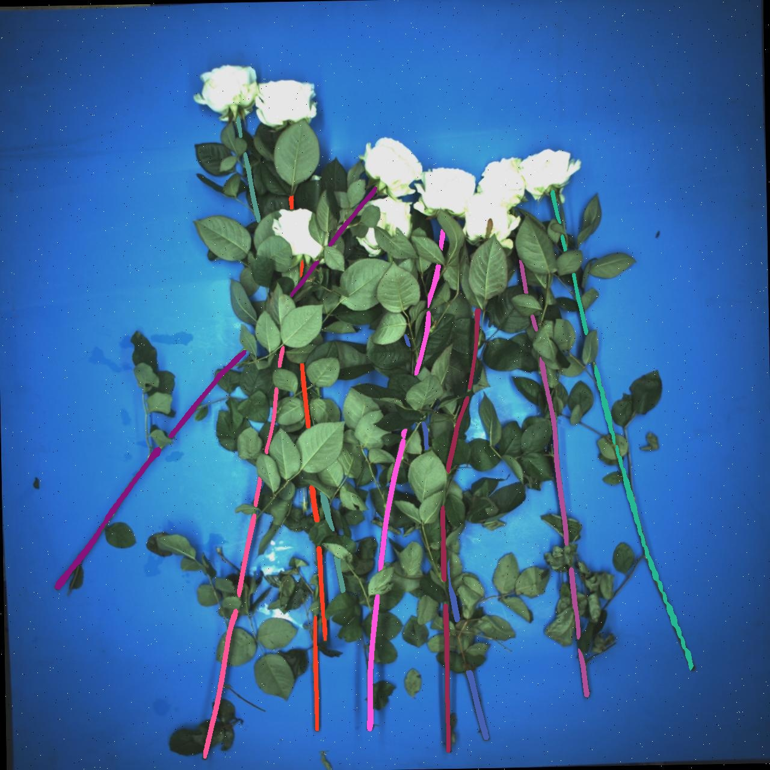
Stem Pairing Conclusion
Week 12 Hua Jiang

Slide 2
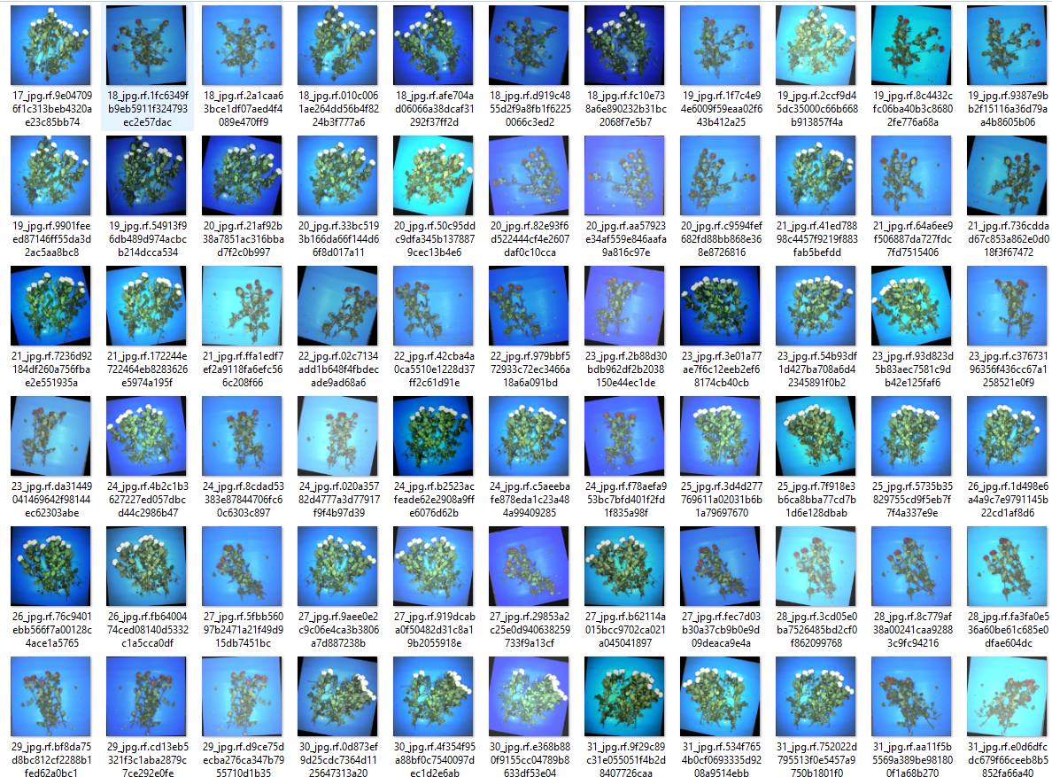
Last Week:
Tunning parameters and I changed the main pairing strategy!
Successfully passed the test sets from 19 – 32, around 66 images

Slide 3
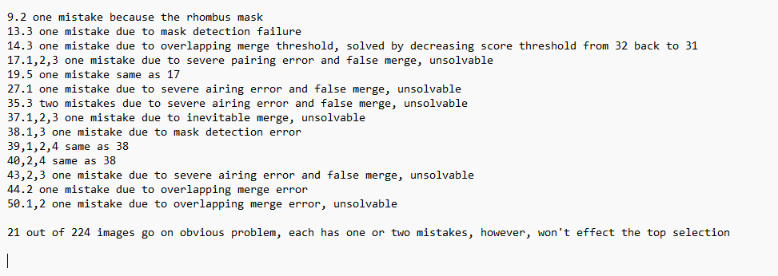
This week: completed the code and tested on the overall dataset

Slide 4
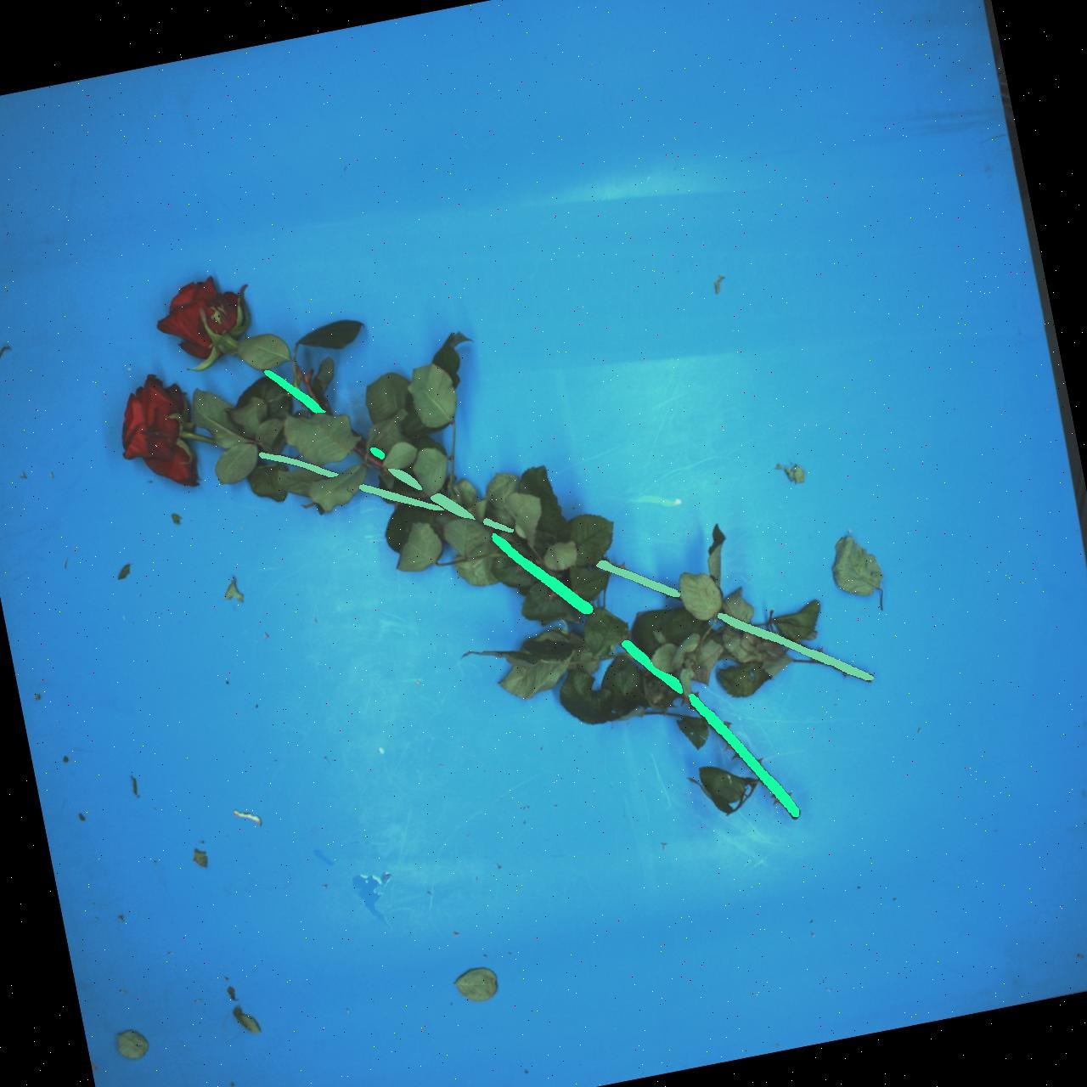
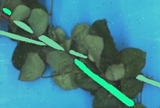
Case 1:
Rhombus Problem
2
1
3

Slide 5
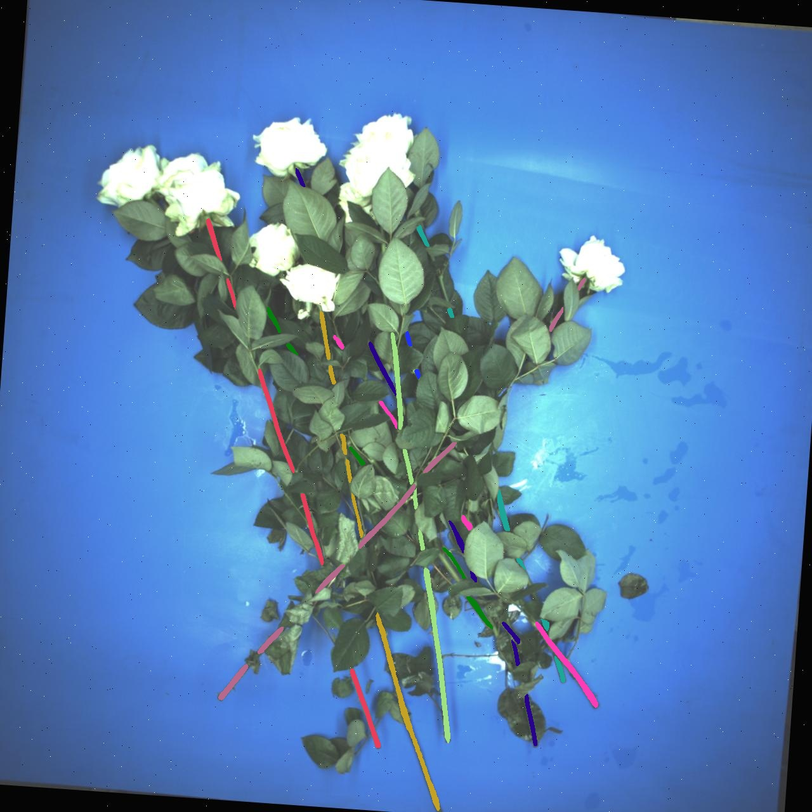
Case 2:
This two are merged together in the last stage

Slide 6
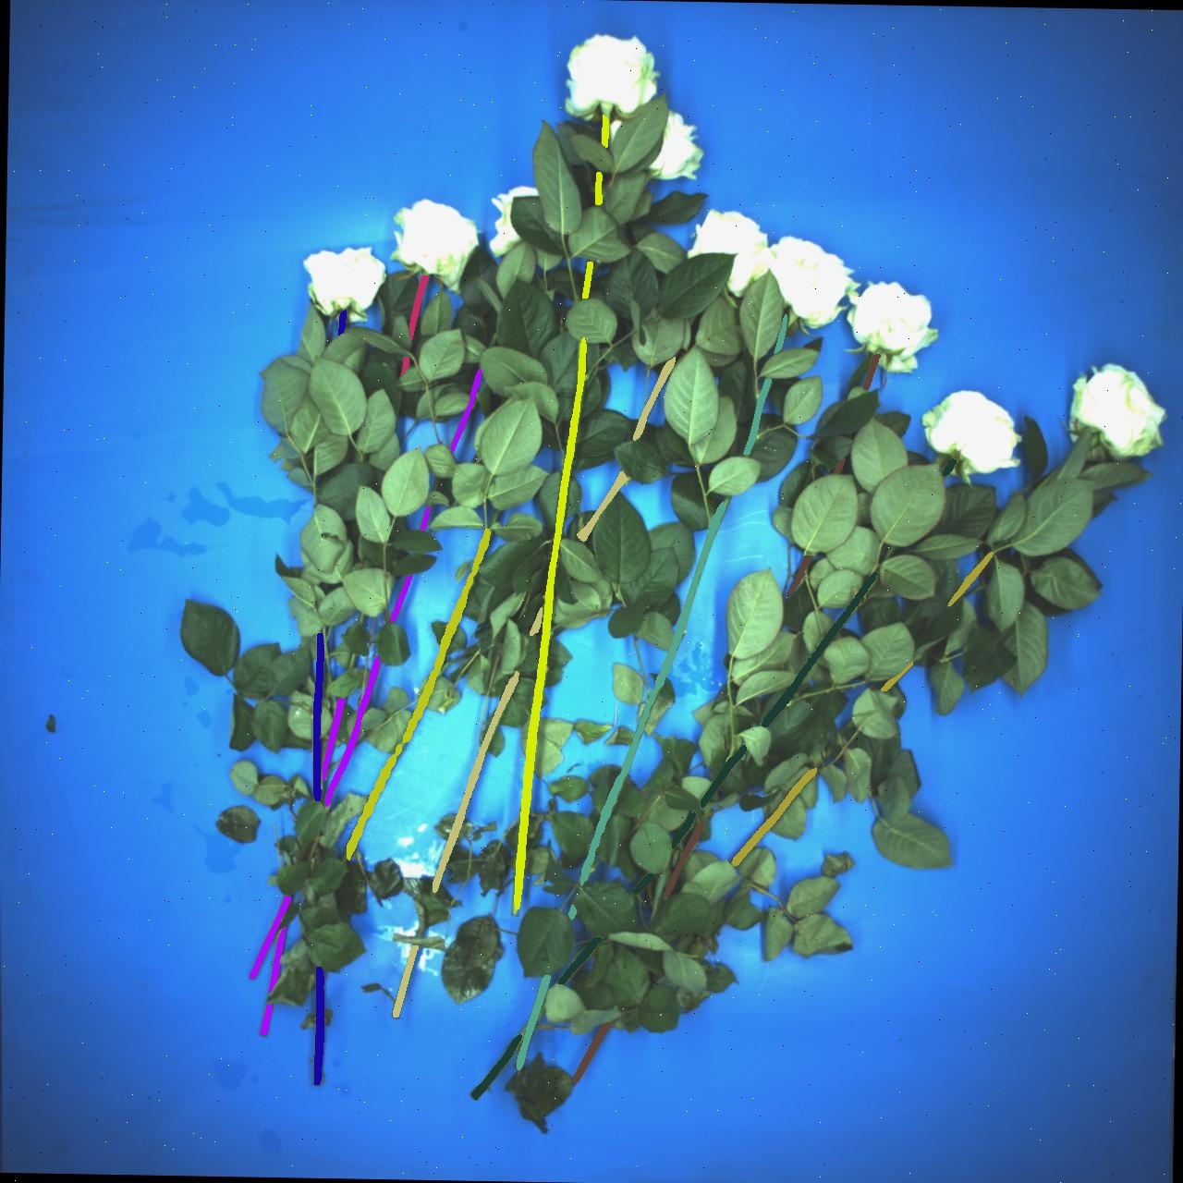
Case 3:
This two are merged together in the last stage

Slide 7
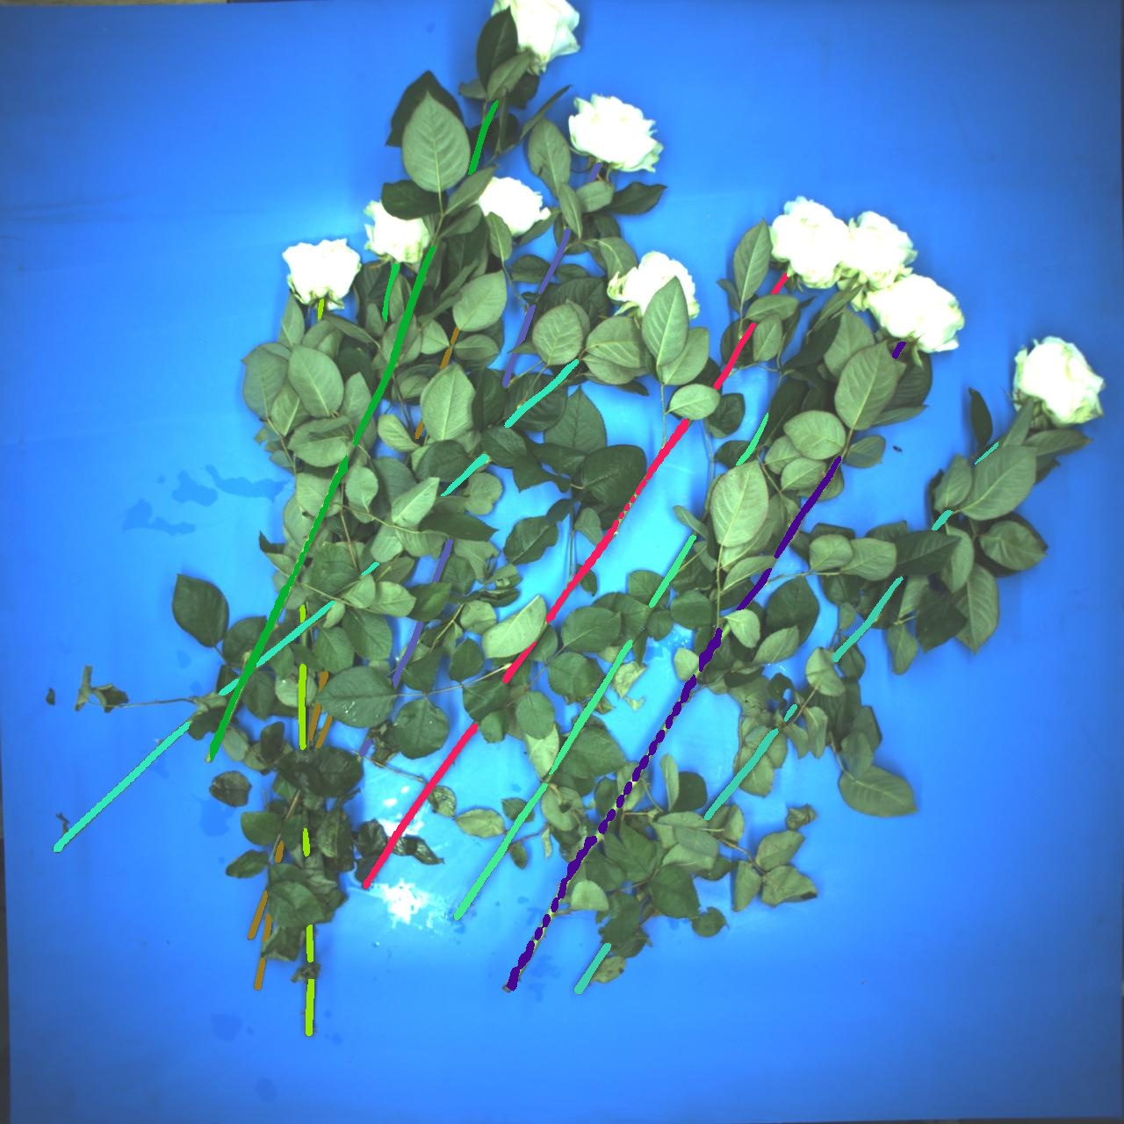
Case 3:
This two are merged together in the last stage

Slide 8
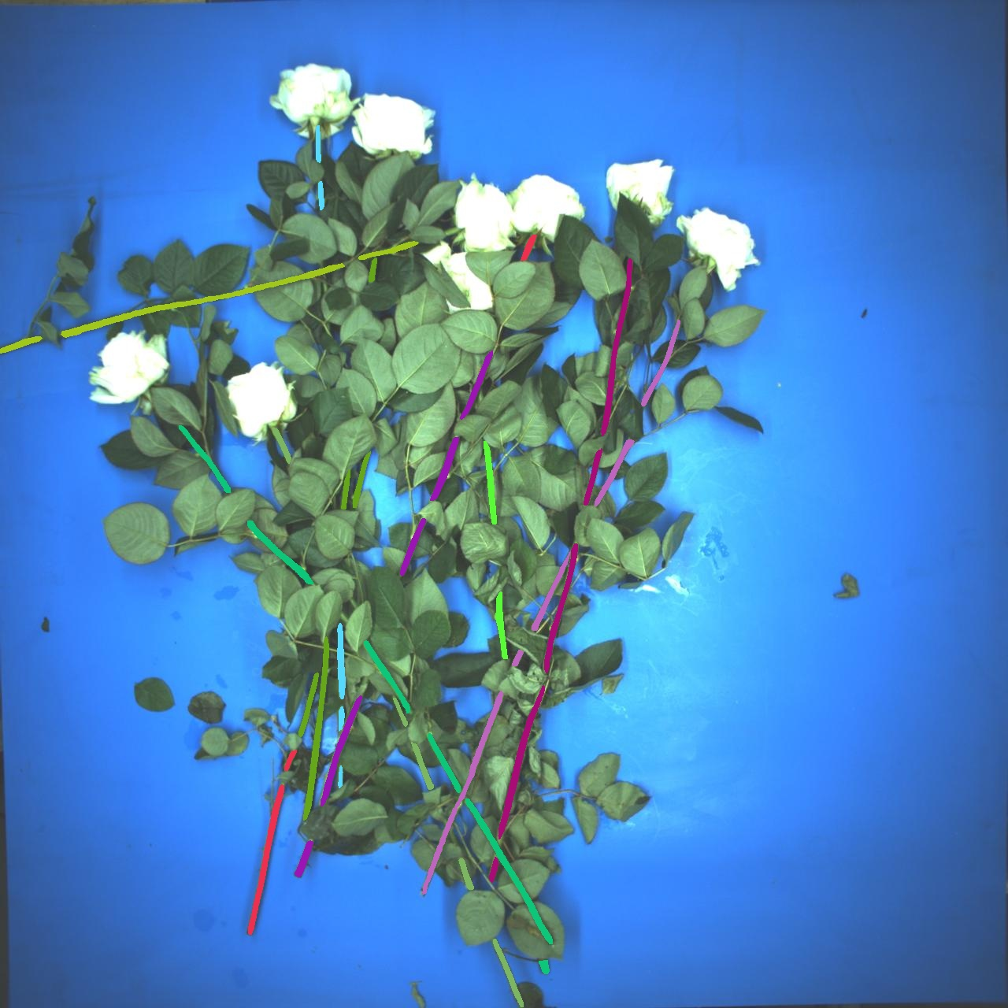
Case 4:
This two are merged together in the last stage

Slide 9
Case 5:
When two flowers overlap at the same position and very similar orientation
This two are merged together in the last stage

Slide 10
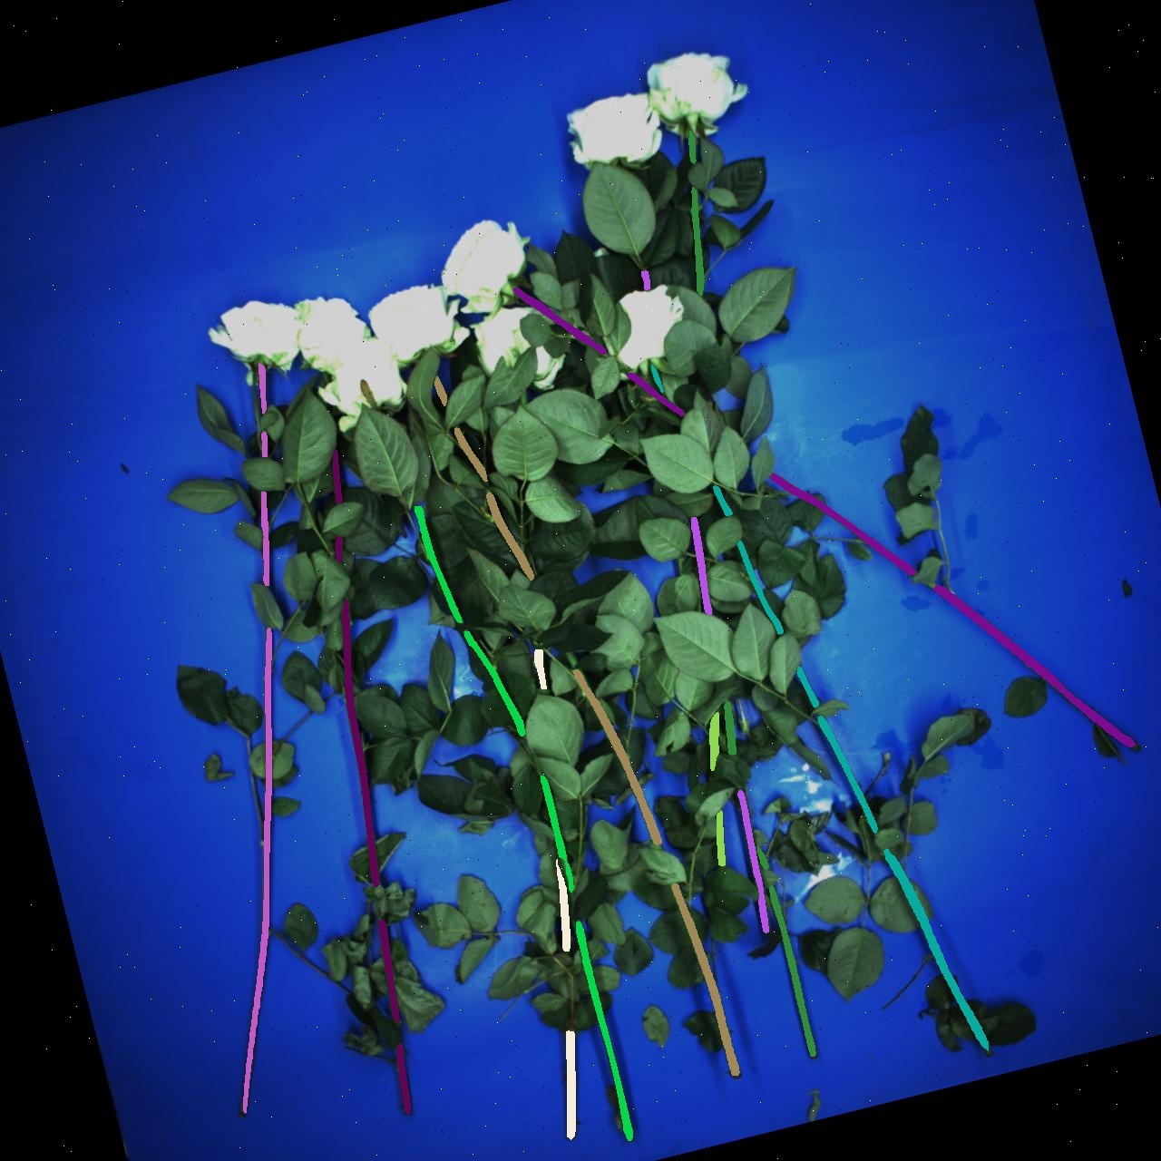
Case 6:
Weird but reasonable

Slide 11

Case 7:

Slide 12
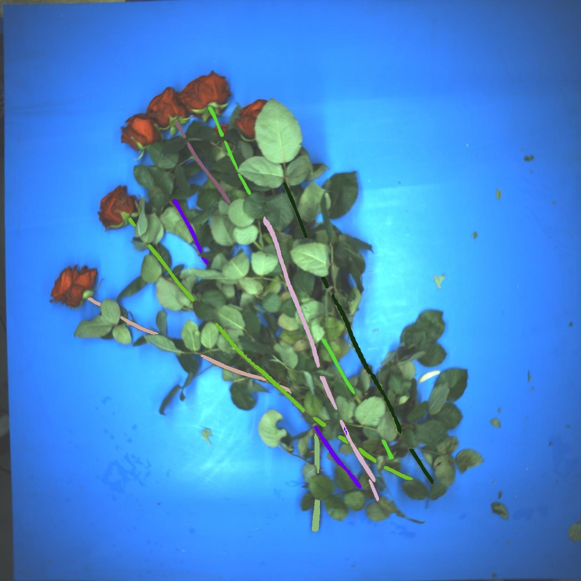
Case 8:
Weird but reasonable

Slide 13
Case 8:
Weird but reasonable

